Slide 1
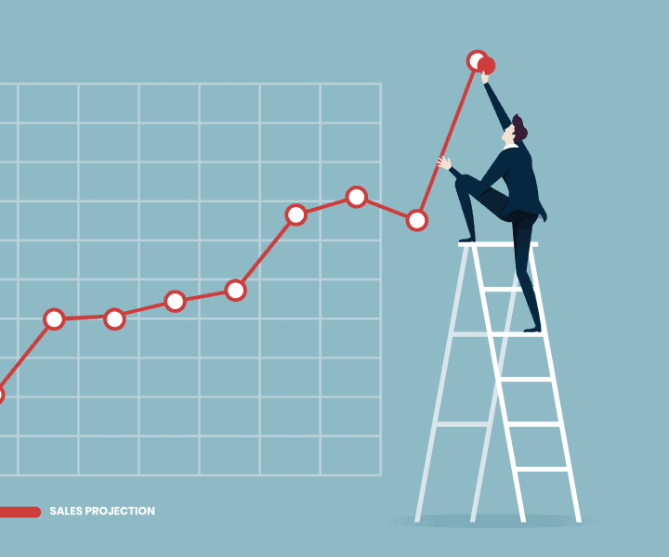
BUSINESS ANALYTICS AND PREDICTION

Slide 2
Know what your customers want most and what your company does best. Focus on where those two meet.
-Kevin Stirtz

Slide 3


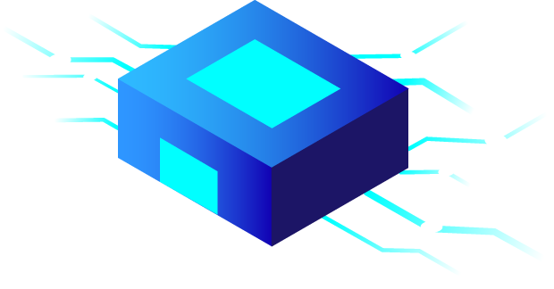

1.
Customer Analysis
Let’s start with the first set of slides

Slide 4
What is Customer Analysis
Customer analysis combines qualitative and quantitative research methods with the goal of better understanding of your customer base. Knowing what makes your customers tick means you’ll be able to cater to their specific needs.
Identifying who your customers are.
Discovering their needs and their pain points.
Grouping customers according to similar traits and behaviors.
Creating a profile of your ideal customer(s).

Slide 5
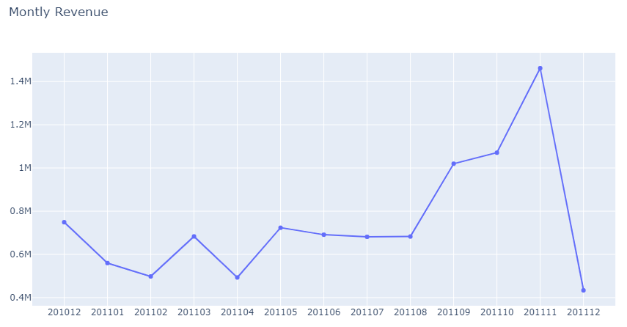
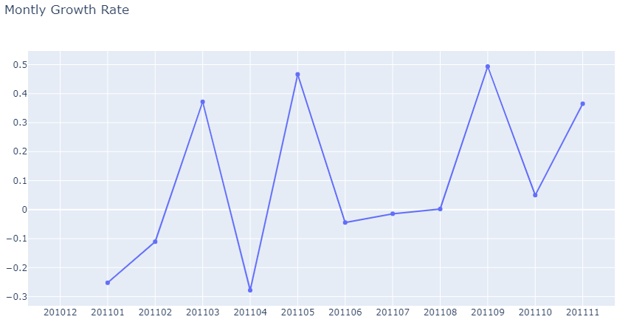
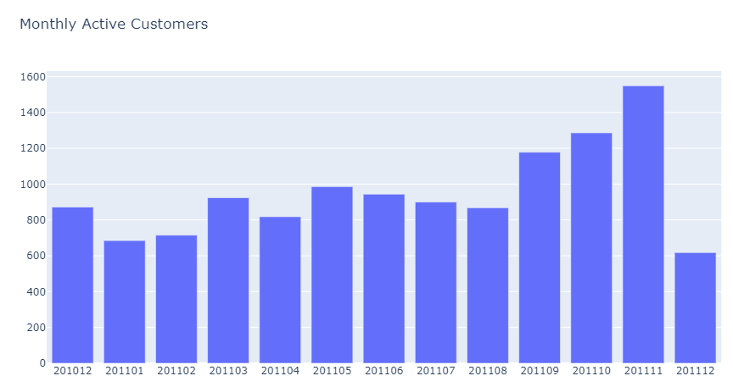
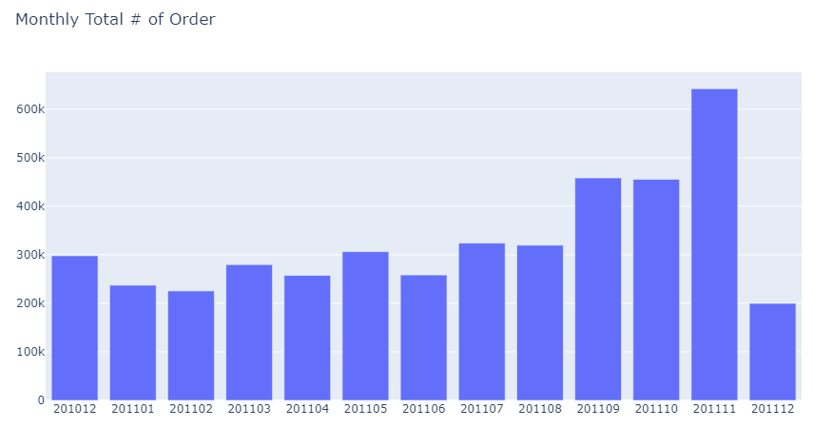

Slide 6
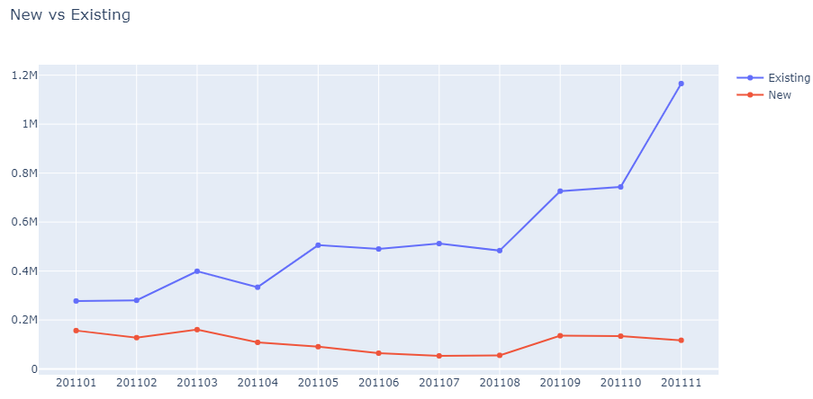
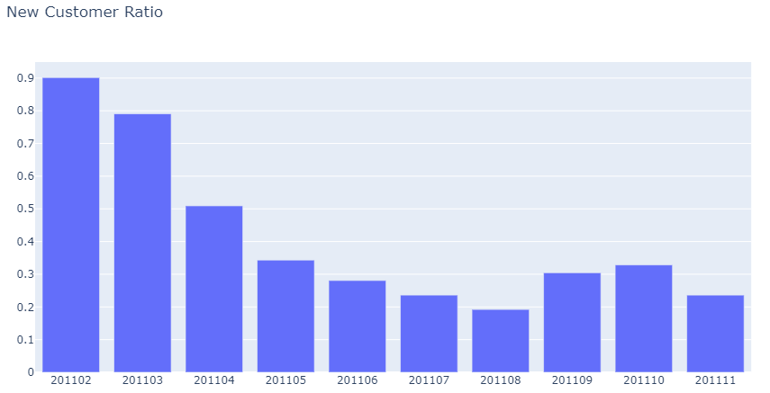
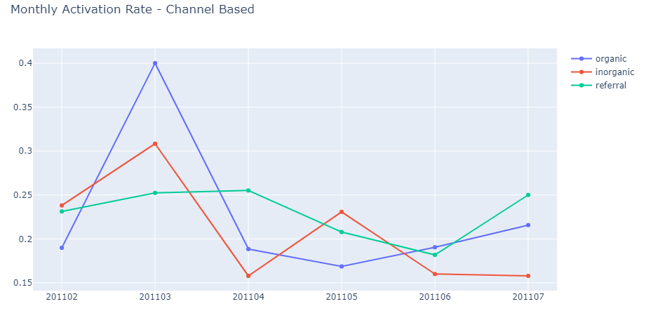
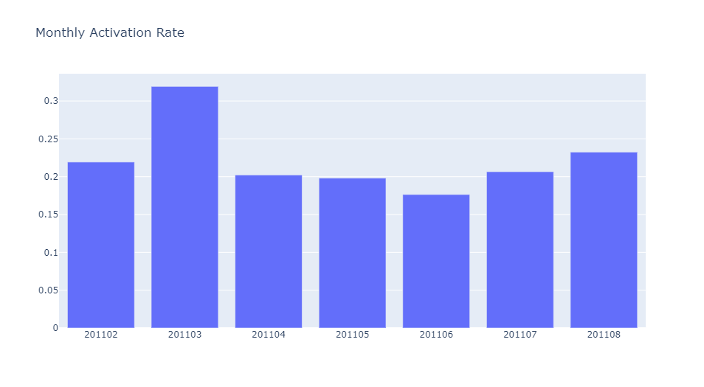

Slide 7
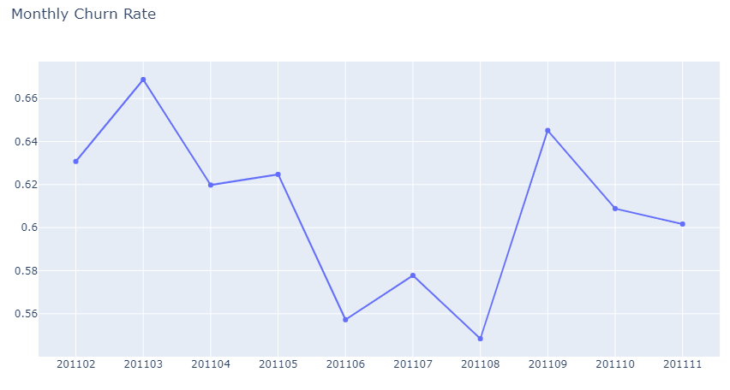
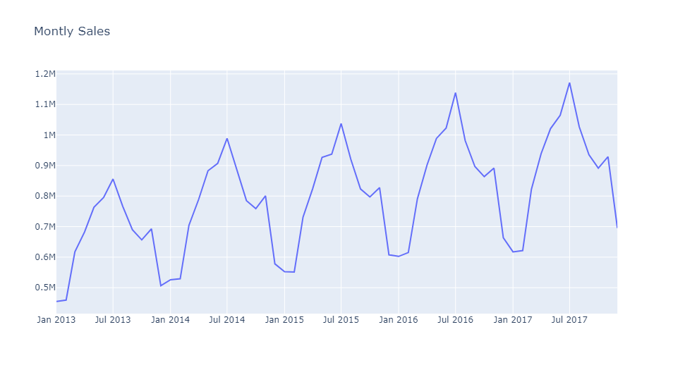
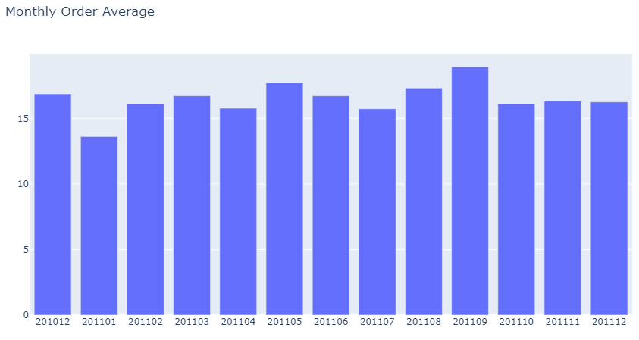
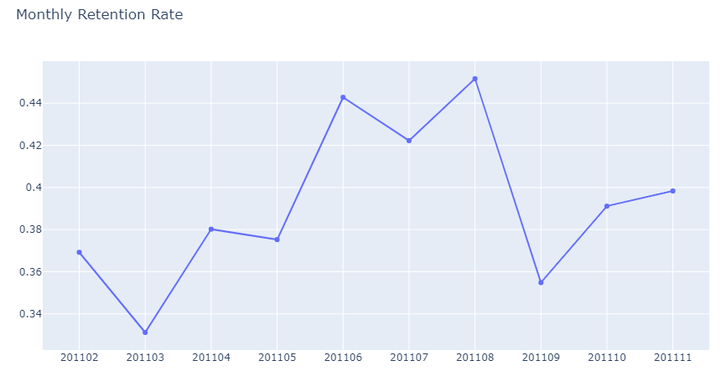

Slide 8
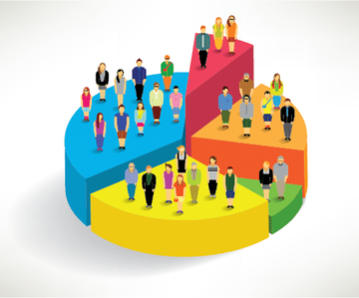
2.
Customer Segmentation
Let’s start with the first set of slides

Slide 9
What is Market Segmentation?
Market segmentation is the process of dividing up the total market based on identifiable characteristics, which have common needs. You can also apply the concept of market segmentation to your customers. For example, you can segment your customers based on the cost to service, the size of the average sale or the number of transactions.

Slide 10
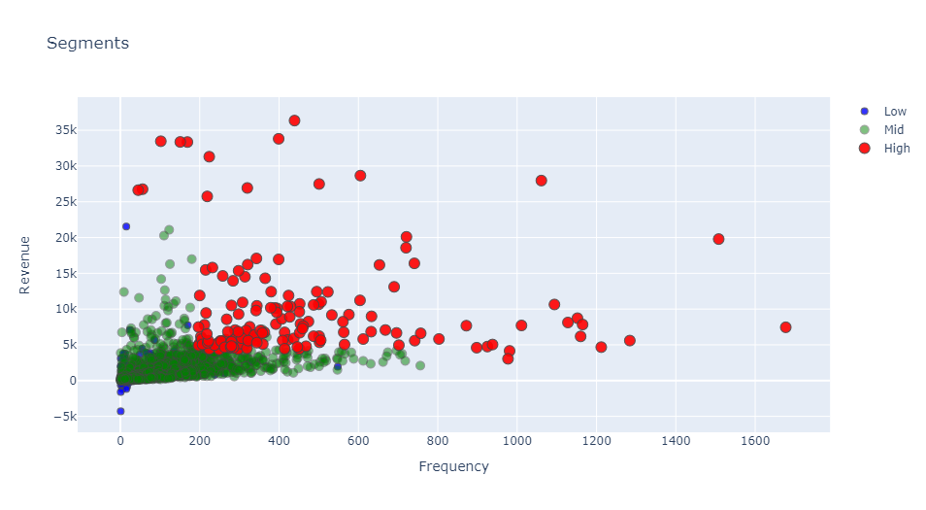

Slide 11
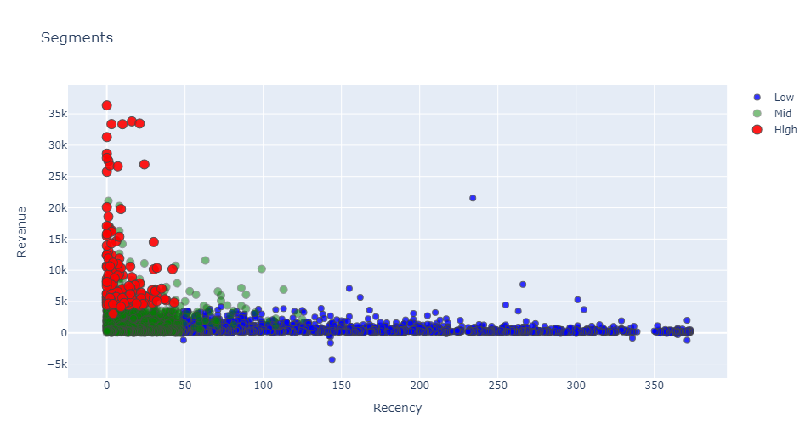

Slide 12
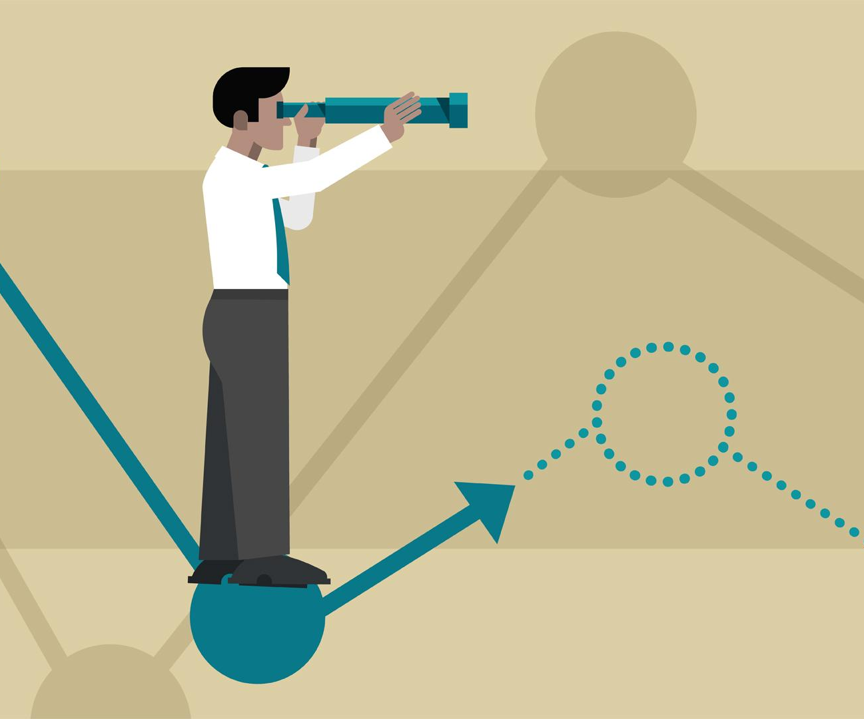
3.
Predicting Sales

Slide 13
What is Sales Prediction?
A sales prediction is a prediction of future sales revenue. Sales prediction are usually based on historical data, industry trends, and the status of the current sales pipeline.
Businesses use the sales forecast to estimate weekly, monthly, quarterly, and annual sales totals.
We got 92% accuracy in the sales prediction

Slide 14
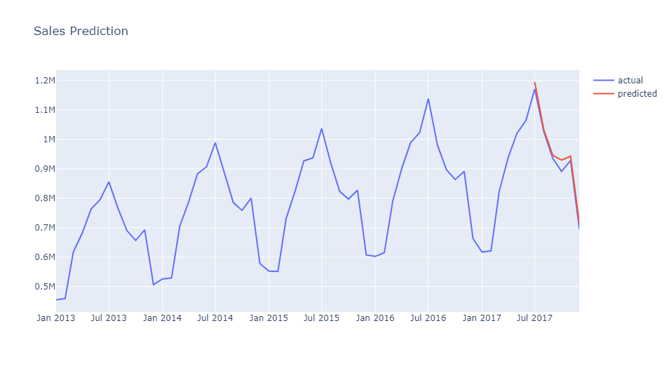

Slide 15

Implementation

Slide 16
Technologies Used
Language: Python
Environment: Jupyter Notebook
Algorithm: Long Short Term Memory (RNN)
Libraries:
Numpy
Pandas
Seaborn
Matplotlib
Plotly

Slide 17
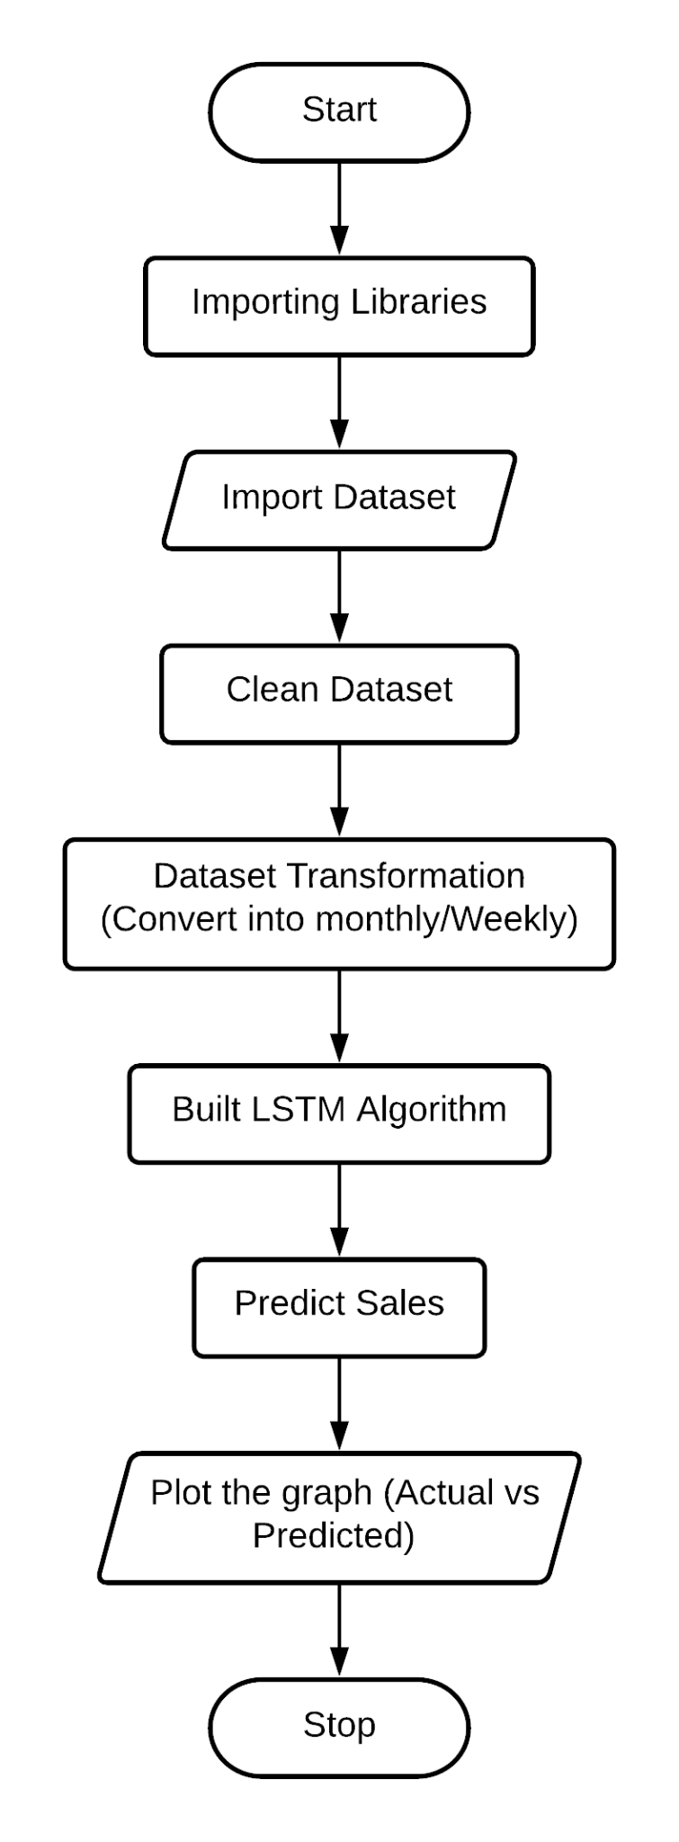
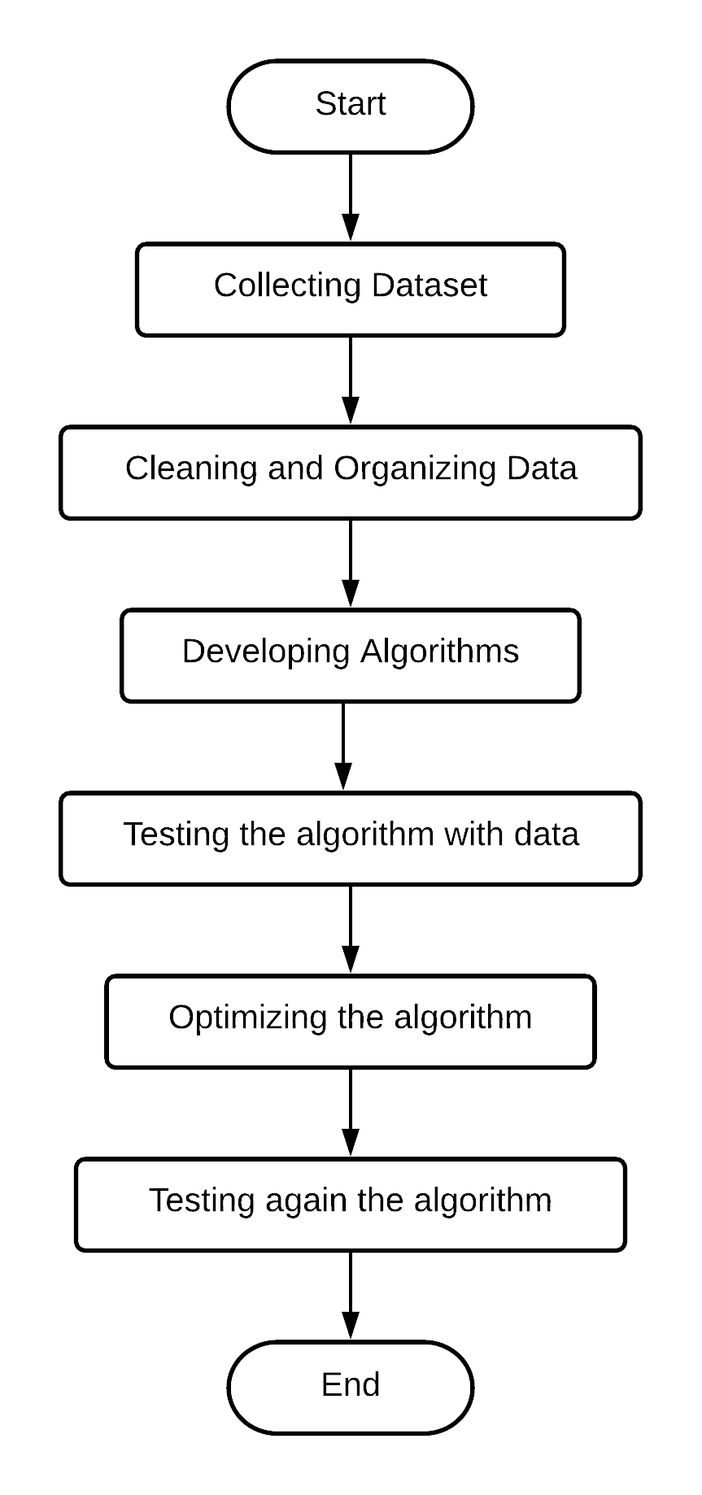
Flow Chart

Slide 18
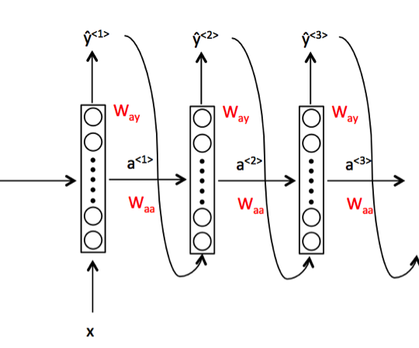
LSTM Model (RNN)
It is special kind of recurrent neural network that is capable of learning long term dependencies in data. This is achieved because the recurring module of the model has a combination of four layers interacting with each other.
LSTM has the ability to remove or add information to the cell state, carefully regulated by structures called gates.

Slide 19
Questions
Why Customer Analysis?
What benefits we can get with this project?
What we have used to make this project?
How this project can offer value to a Businesses?
What are the extra cost for this project and is it worth it?

Slide 20

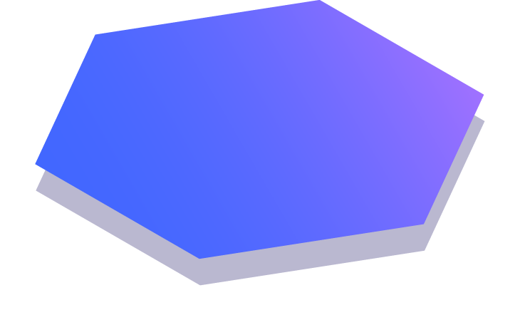
Thanks!
Any questions?
You can find me at:
@username
user@mail.me
Submitted By:
Deepanshu Jayswal
1728263

